Slide 1
lionkingministries.com
Pick up your copy of my book SAVED TWICE
& STAND FIRM with me in your Faith for Jesus!

Slide 2
Andy Peterson’s
True Life Story Featured On

Slide 3
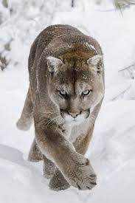
Male lions can weigh 175 lbs. Females 150 lbs. Some have been known to exceed 200 lbs.

Slide 4
Lion’s favorite meal is deer. They can take down an elk, moose, and even a porcupine.

Slide 5
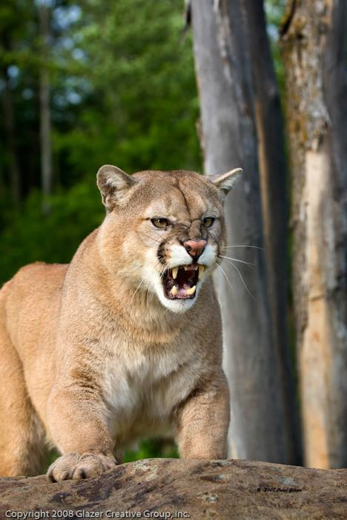
Lions have been known to jump over a 10-foot fence with a 100 lb. animal in its mouth.

Slide 6
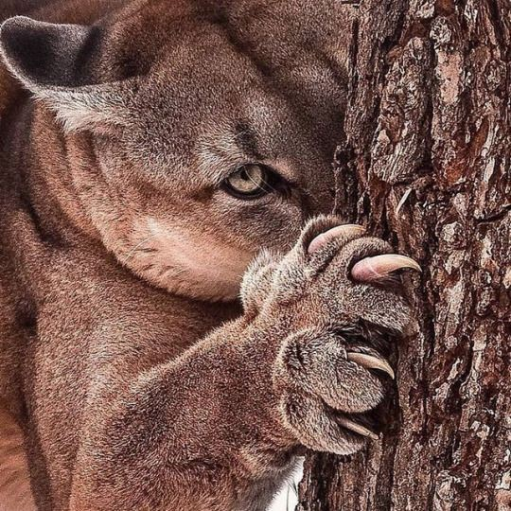
Lions have been known to jump over a 20-foot fence.

Slide 7
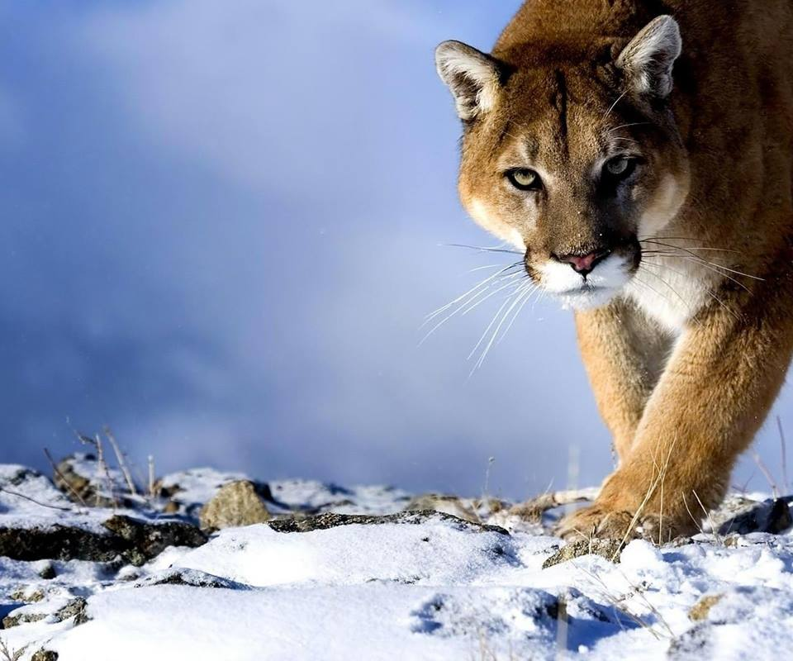
Lions can jump 40 feet horizontal in length.

Slide 8
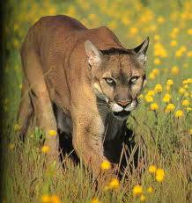
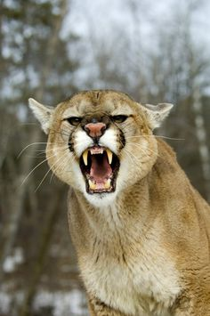
Lions can reach speeds of 50mph in a chase (us = 28mph).

Slide 9
lionkingministries.com

Slide 10
lionkingministries.com

Slide 11
lionkingministries.com

Slide 12
lionkingministries.com

Slide 13
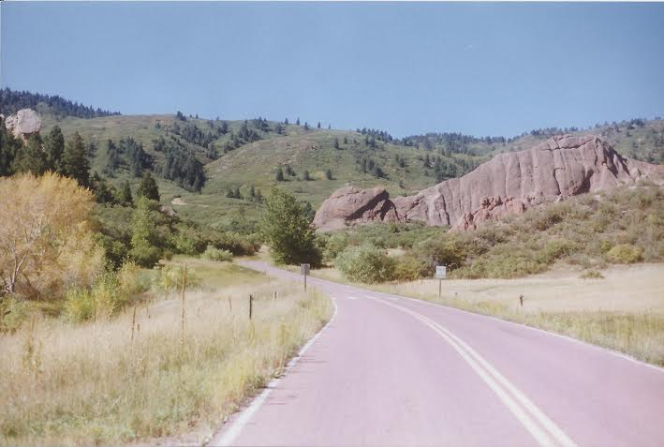
lionkingministries.com

Slide 14
lionkingministries.com

Slide 15
lionkingministries.com

Slide 16
lionkingministries.com

Slide 17
lionkingministries.com

Slide 18
lionkingministries.com

Slide 19
lionkingministries.com

Slide 20
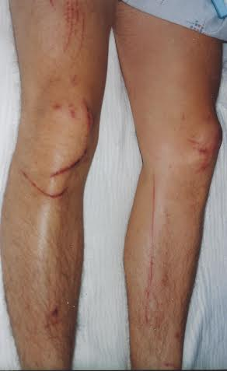
lionkingministries.com

Slide 21
lionkingministries.com

Slide 22
lionkingministries.com

Slide 23
lionkingministries.com

Slide 24
lionkingministries.com

Slide 25
lionkingministries.com

Slide 26
Roxborough State Park, Colorado Carpenter Peak Trail Summit Dedicated Bench

Slide 27
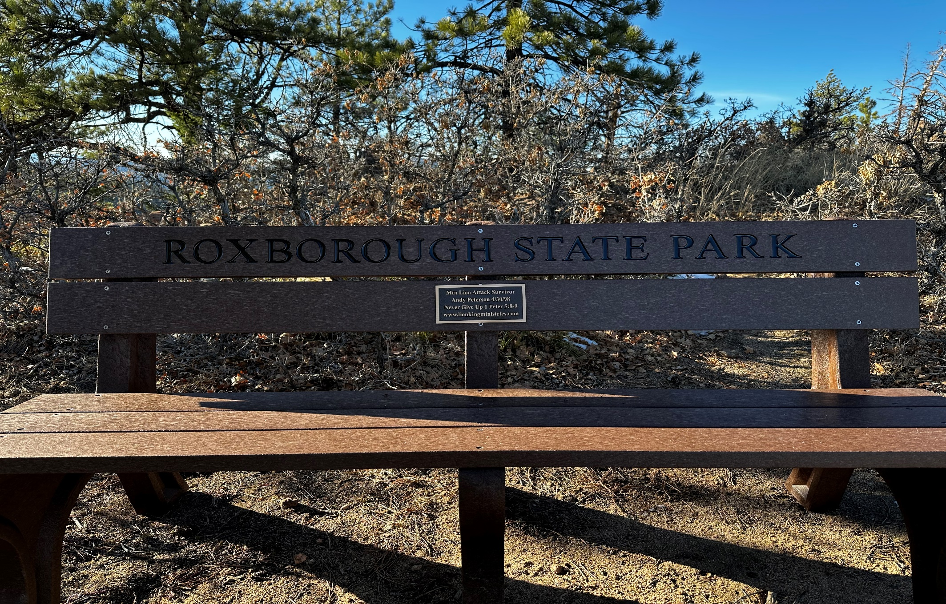
Roxborough State Park, Colorado Carpenter Peak Trail Summit Dedicated Bench

Slide 28
Roxborough State Park, Colorado
Carpenter Peak Trail Summit Bench Plaque

Slide 29
lionkingministries.com
Are
You
Ready
for a…
Second Chance? Jesus Loves You!
TAKE THAT STEP!!!

Slide 30
lionkingministries.com
1 Peter 5:8-9
Be self-controlled and alert, your enemy the devil roams around like a roaring lion looking for someone to devour. Resist him, STANDING FIRM in the faith…

Slide 31
lionkingministries.com
2 Chronicles 16:9
For the eyes of the Lord range throughout the earth to strengthen those who’s hearts are FULLY committed to Him.

Slide 32
lionkingministries.com
Thank you and God Bless!
Schedule Andy to speak at your next event!
Did my true story inspire you?
Please follow & share
Lion King Ministries on Social Media!
facebook.com/lionkingministries
instagram.com/thepetersonrealestateteam

